Slide 1
Operating system
Part VIII: Memory (basic)
By KONG LingBo (孔令波)

Slide 2
Problems:
VM (Virtual Memory) is usually considered as the modern way to overcome the memory limitation for running a program whose size is larger than the physical memory – “Large program but small memory”
However, overlay, dynamic linking etc. can also be used for that
What’s exactly the difference?
Notes:
2012年6月19日19:57:28

Slide 3
Declaration
The content of Silbersatz’s book leads to a confusion
It splits Paging, Segmenting techniques from the concept of virtual memory.
In fact, they are part of the techniques used to support VM concept!
http://en.wikipedia.org/wiki/Paging
“Paging is an important part of virtual memory implementation in most contemporary general-purpose operating systems, allowing them to use disk storage for data that does not fit into physical random-access memory (RAM).”

Slide 4
More reasonable organization
MM with two parts
Basic concepts and techniques
Techniques supporting the mapping from logical address to physical address
Old ways to manage main memory for executing programs
Partitioning, Overlays/Swapping
Virtual Memory (VM)
(On-demand) Paging scheme, Segmenting scheme, Segment-Page scheme
Notes:
on demand 一经要求
This check is payable on demand.
这是一张见票即付的支票。
Passengers must show their tickets on demand.
查票时乘客须出示车票。

Slide 5
Goals
Know the basic concepts of MM
Hierarchy of storage medias
Static/Dynamic Linking, Relocation, Protection
Overlay
Partitioning schemes
Fixed/Variable partition
Replacement algorithms

Slide 6
Memory
Basic concepts
From Logic address to physical address
MMU for relocation – address translation
Basic techniques of real memory management
Overlay
Dynamic linking
Partitioning (Static & Dynamic)
For OS space
Knuth’s Buddy System
Notes:
[2012-10-19]
1. 有些内容已经删除了, 但是, 新幻灯片没有更正 – 已更正这里的目录
2. 内存管理就是做两件事: 空间分配和地址翻译(重定位)
在空间分配时, 早期有分区和覆盖; 当然现在主要是虚拟内存(分页, 分段, 段页)等

Slide 7
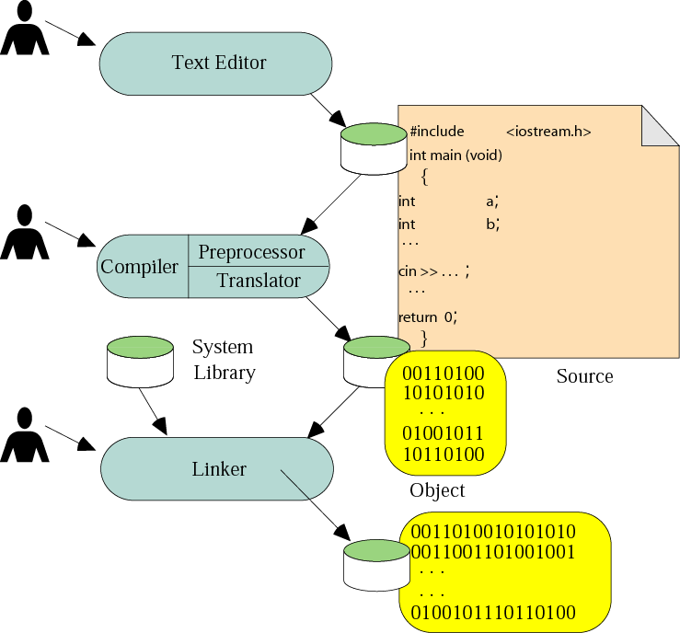
WE have learned: Building a program
00.Computer & Related\PPTs.2009\Part I Program & Programming.pptx

Slide 8
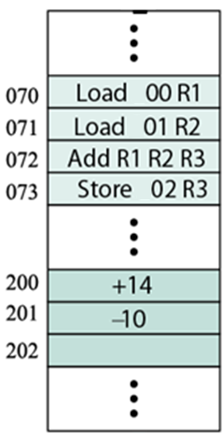

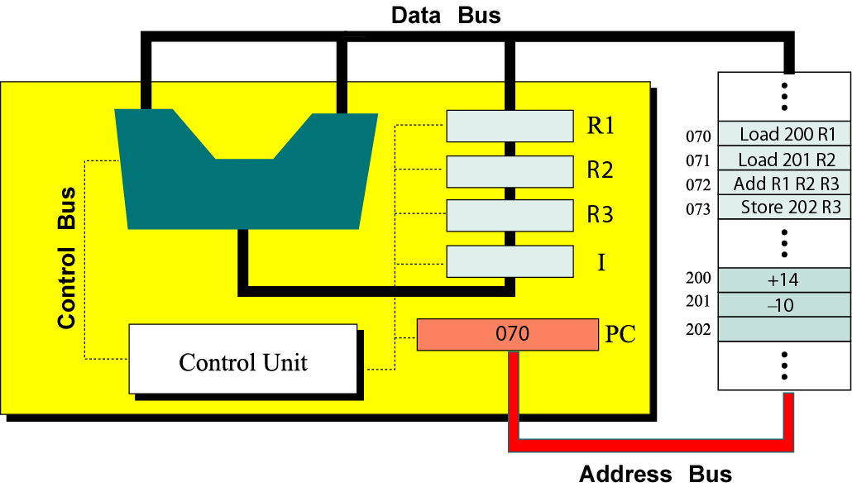
BUT, How are the instructions transferred into the main memory?
Program
X=14;
Y= -10;
Z= X+Y;
Assembly
Load 00 R1;
Load 01 R2;
ADD R1 R2 R3;
Store 02 R3;
Machine code
[00] 14 (should be bin)
[01] -10
[02] (used later)
[03] 0001 00000000
[04] 0010 00000001
[05] 0011
[06] 0100 00000010

Slide 9
Logical address [逻辑地址] → Program space → File Space
An address of one instruction or data item inside program space is commonly referred to as a logical address
Physical address [物理地址] → Hard Disk Space → MM Space
whereas an address of one instruction or data item in the memory unit commonly referred to as a physical address, which could be really accessed by CPU.
To my thinking, addresses in HDD should also be understood as Physical Address

Slide 10
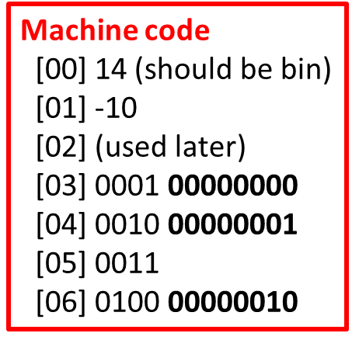

2 tasks for MM – also for HDD
With the mapping slide, we can infer there are 2 tasks
Memory allocation
Given the segment of a program, assign a block/region in MM to keep that segment – namely copy the numbered instructions together with the necessary data to that block/region
Address translation
Even the instructions are copied to the memory block, some logic addresses are also kept with some instructions

Slide 11
some logic addresses are still conveyed into the MM as the parameters of some instructions
Program
X=14;
Y= -10;
Z= X+Y;
Machine code in MM
[200] 14
[201] -10
[202]
[070] 0001 00000000
[071] 0010 00000001
[072] 0011
[073] 0100 00000011
Machine code
[00] 14 (should be bin)
[01] -10
[02] (used later)
[03] 0001 00000000
[04] 0010 00000001
[05] 0011
[06] 0100 00000010

Slide 12
Relocation [重定位] – Address translation
The concept to compute the physical addresses of the logic addresses like above
Problem: given the start position and the size of the block which is assigned to the segment, you are asked to compute the physical address of the memory unit to store the corresponding logic address
Called relocation!
MMU – Memory Management Unit
The run-time mapping from logical to physical addresses is done by a hardware device called the memory-management unit.

Slide 13
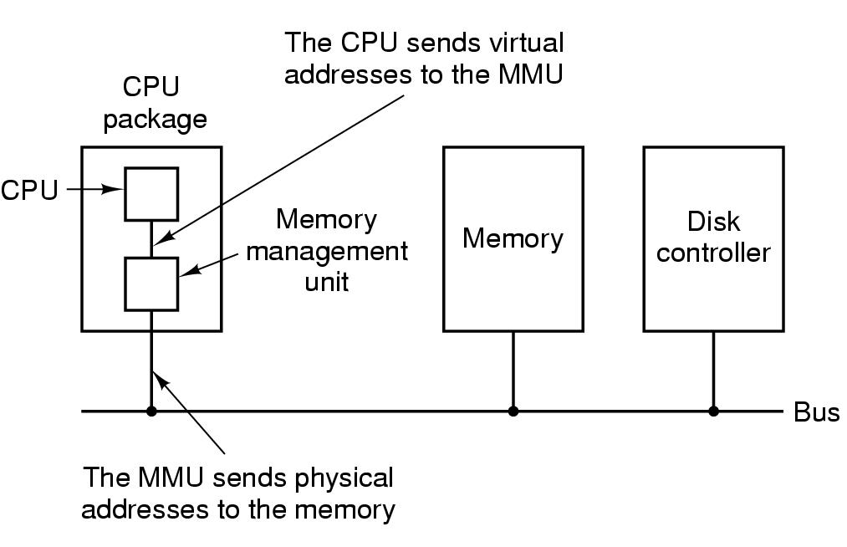
CPU, MMU and Memory
Notes:
So, modern CPU contains 4 components – ALU, CU, Register Set, MMU

Slide 14
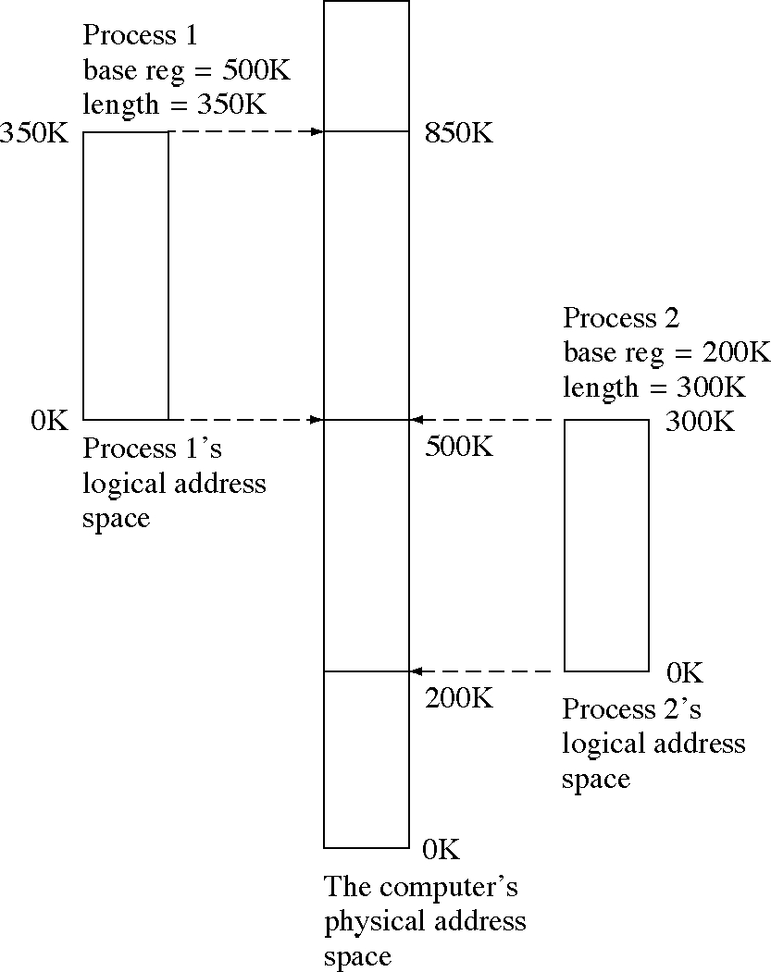
Logical and Physical Address Spaces
Region information should be kept – starting address, and size

Slide 15
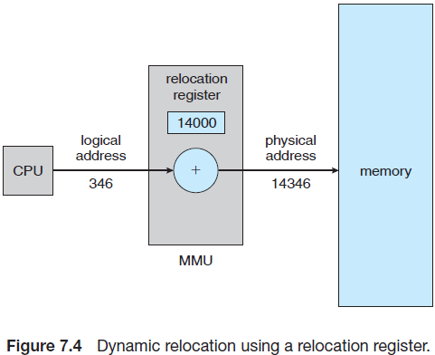
MMU – starting address + size as parameters
Starting address of the region assigned to your program
Logical address

Slide 16
Memory Management Requirements (2)
Protection:
Processes should not be able to reference memory locations in another process without permission.
Impossible to check addresses in programs at compile/load-time since the program could be relocated.
Address references must be checked at execution-time by hardware.
PPTs from others\From Ariel J. Frank\OS381\os7-1_rea.ppt

Slide 17
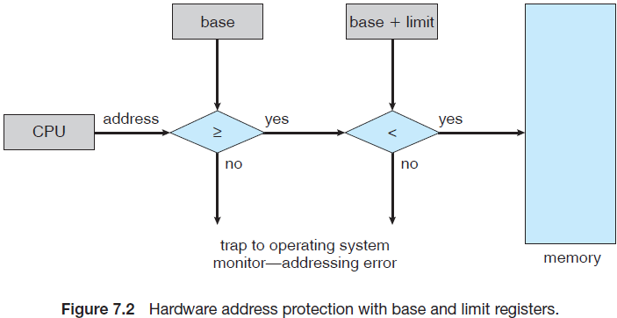
Limit corresponds to the Size of the region assigned to your program
Protection of memory space is accomplished by having the CPU hardware compare every address generated in user mode with the registers.
Any attempt by a program executing in user mode to access operating-system memory or other users’ memory results in a trap to the operating system, which treats the attempt as a fatal error

Slide 18
Memory
Basic concepts
Memory in storage hierarchy
From program to process
Static & Dynamic linking
Requirements of MM
Basic techniques of real memory management
Partitioning (Static & Dynamic)
Other auxiliary skills – Overlay and DDL
For OS space
Knuth’s Buddy System

Slide 19
Real Memory Management Techniques
Although the following simple/basic memory management techniques are not used in modern OSs, they lay the ground for a later proper discussion of virtual memory:
Fixed/Static Partitioning
Variable/Dynamic Partitioning
In fact, I think that the basis of modern MM is partition and swapping
PPTs from others\From Ariel J. Frank\OS381\os7-2_rea.ppt

Slide 20
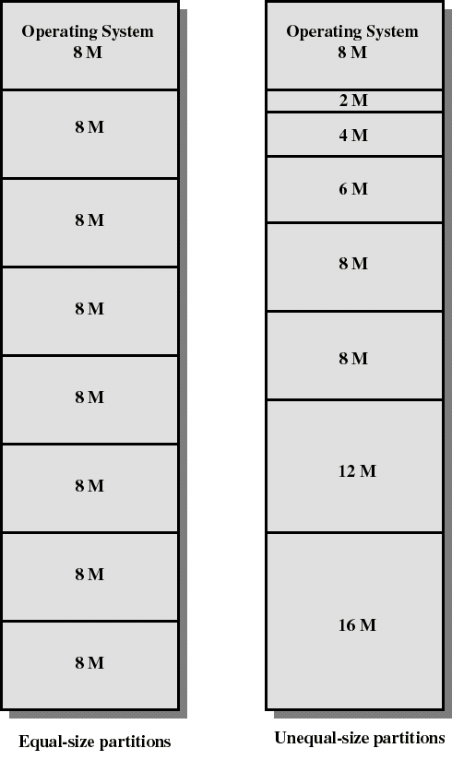
Fixed Partitioning
Partition main memory into a set of non-overlapping memory regions called partitions.
Fixed partitions can be of equal or unequal sizes.
Leftover [剩余的；边角料的] space in partition, after program assignment, is called internal fragmentation [内部碎片；内零头].
PPTs from others\From Ariel J. Frank\OS381\os7-2_rea.ppt

Slide 21
Placement Algorithm with Partitions
Equal-size partitions:
If there is an available partition, a process can be loaded into that partition –
because all partitions are of equal size, it does not matter which partition is used.
If all partitions are occupied by blocked processes, choose one process to swap out to make room for the new process.
PPTs from others\From Ariel J. Frank\OS381\os7-2_rea.ppt

Slide 22
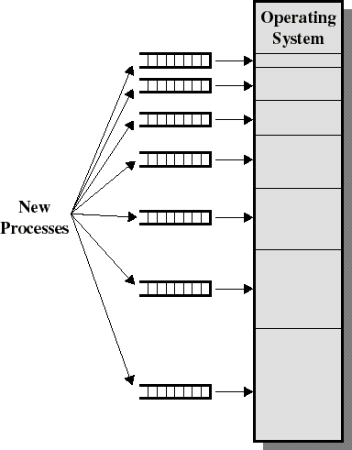
Placement Algorithm with Partitions
Unequal-size partitions, using multiple queues:
assign each process to the smallest partition within which it will fit.
a queue exists for each partition size.
tries to minimize internal fragmentation.
problem: some queues might be empty while some might be loaded.
PPTs from others\From Ariel J. Frank\OS381\os7-2_rea.ppt

Slide 23
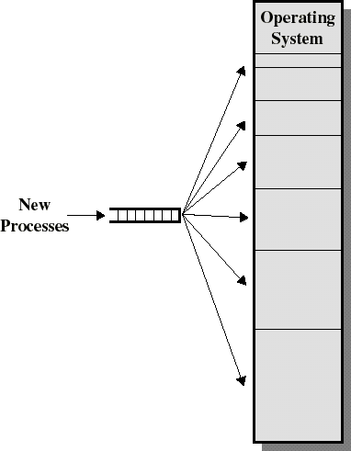
Placement Algorithm with Partitions
Unequal-size partitions, using a single queue:
when its time to load a process into memory, the smallest available partition that will hold the process is selected.
increases the level of multiprogramming at the expense of internal fragmentation.
Because, maybe later process requires smaller space, but there is no available partition
PPTs from others\From Ariel J. Frank\OS381\os7-2_rea.ppt

Slide 24
Fixed Partitioning with Swapping
 | memory
 | OS
2K | P1
6K | P2
12K | empty
P3
Secondary
storage
P4
P5
empty
PPTs.2012\PPTs from others\www.eee.metu.edu.tr_~halici_courses_442\ch3part1.ppt

Slide 25
Fixed Partitioning with Swapping
 | memory
 | OS
2K
6K | P2
12K | empty
Swap out
P1
P3
P1
Secondary
storage
P4
P5
empty
PPTs.2012\PPTs from others\www.eee.metu.edu.tr_~halici_courses_442\ch3part1.ppt

Slide 26
Fixed Partitioning with Swapping
 | memory
 | OS
2K | P3
6K | P2
12K | empty
Swap in
P3
P1
Secondary
storage
P4
P5
empty
PPTs.2012\PPTs from others\www.eee.metu.edu.tr_~halici_courses_442\ch3part1.ppt

Slide 27
Fixed Partitioning with Swapping
 | memory
 | OS
2K | P3
6K | P2
12K | empty
P1
Secondary
storage
P4
P5
empty
PPTs.2012\PPTs from others\www.eee.metu.edu.tr_~halici_courses_442\ch3part1.ppt

Slide 28
Fixed Partitioning with Swapping
 | memory
 | OS
2K
6K | P2
12K | empty
Swap out
P3
P1
P3
Secondary
storage
P4
P5
empty
PPTs.2012\PPTs from others\www.eee.metu.edu.tr_~halici_courses_442\ch3part1.ppt

Slide 29
Fixed Partitioning with Swapping
 | memory
 | OS
2K | P1
6K | P2
12K | empty
Swap in
P1
P3
Secondary
storage
P4
P5
empty
PPTs.2012\PPTs from others\www.eee.metu.edu.tr_~halici_courses_442\ch3part1.ppt

Slide 30
Fixed Partitioning with Swapping
 | memory
 | OS
2K | P1
6K | P2
12K | empty
P3
Secondary
storage
P4
P5
empty
PPTs.2012\PPTs from others\www.eee.metu.edu.tr_~halici_courses_442\ch3part1.ppt

Slide 31
Variable Partitioning
When a process arrives, it is allocated with memory from a hole large enough to accommodate it.
Hole – block/region of available memory; holes of various sizes are scattered throughout memory.
Operating system maintains information about: a) allocated partitions b) free partitions (holes/regions)
OS
OS
OS
OS
process 5
process 5
process 5
process 5
process 9
process 9
process 8
process 10
process 2
process 2
process 2
process 2
PPTs from others\From Ariel J. Frank\OS381\os7-2_rea.ppt

Slide 32
Dynamic Partitioning Placement Algorithm
Operating system must decide which free block to allocate to a process
Best-fit algorithm(最佳适配)
Chooses the block that is closest in size to the request
Worst performer overall
Since smallest block is found for process, the smallest amount of fragmentation is left
Memory compaction must be done more often
PPTs from others\SCU_Zhaohui\OS\Chapter07.ppt

Slide 33
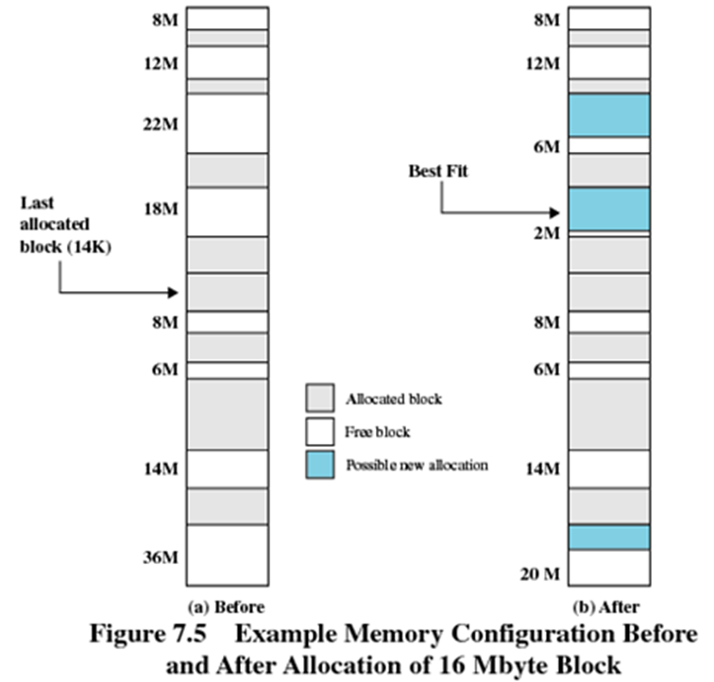


Best fit
Could you draw the situation of the memory after the allocations of series requests: 5, 22, 6, 12?

Slide 34
best fit
OS
P1 12 KB
<FREE> 10 KB
P2 20 KB
<FREE> 16 KB
P3 6 KB
<FREE> 4 KB
Initial memory mapping

Slide 35
best fit
OS
P1 12 KB
<FREE> 10 KB
P2 20 KB
<FREE> 16 KB
P3 6 KB
<FREE> 4 KB
P4 of 3KB
arrives
PPTs.2012\PPTs from others\www.eee.metu.edu.tr_~halici_courses_442\ch3part1.ppt

Slide 36
best fit
OS
P1 12 KB
<FREE> 10 KB
P2 20 KB
<FREE> 16 KB
P3 6 KB
P4 3 KB
<FREE> 1 KB
P4 of 3KB
loaded here by
BEST FIT
PPTs.2012\PPTs from others\www.eee.metu.edu.tr_~halici_courses_442\ch3part1.ppt

Slide 37
best fit
OS
P1 12 KB
<FREE> 10 KB
P2 20 KB
<FREE> 16 KB
P3 6 KB
P4 3 KB
<FREE> 1 KB
P5 of 15KB
arrives
PPTs.2012\PPTs from others\www.eee.metu.edu.tr_~halici_courses_442\ch3part1.ppt

Slide 38
best fit
OS
P1 12 KB
<FREE> 10 KB
P2 20 KB
P5 15 KB
<FREE> 1 KB
P3 6 KB
P4 3 KB
<FREE> 1 KB
P5 of 15 KB
loaded here by
BEST FIT
PPTs.2012\PPTs from others\www.eee.metu.edu.tr_~halici_courses_442\ch3part1.ppt

Slide 39
Dynamic Partitioning Placement Algorithm
Worst-fit (最差适配)
Scans memory from the location of the last placement
Allocate the largest block among those that are large enough for the new process.
Again a search of the entire list or sorting it is needed.
This algorithm produces the largest over block.
PPTs from others\SCU_Zhaohui\OS\Chapter07.ppt
PPTs.2012\PPTs from others\www.eee.metu.edu.tr_~halici_courses_442\ch3part1.ppt

Slide 40
worst fit
OS
P1 12 KB
<FREE> 10 KB
P2 20 KB
<FREE> 16 KB
P3 6 KB
<FREE> 4 KB
Initial memory mapping
PPTs.2012\PPTs from others\www.eee.metu.edu.tr_~halici_courses_442\ch3part1.ppt

Slide 41
worst fit
OS
P1 12 KB
<FREE> 10 KB
P2 20 KB
<FREE> 16 KB
P3 6 KB
<FREE> 4 KB
P4 of 3KB
arrives
PPTs.2012\PPTs from others\www.eee.metu.edu.tr_~halici_courses_442\ch3part1.ppt

Slide 42
worst fit
OS
P1 12 KB
<FREE> 10 KB
P2 20 KB
P4 3 KB
<FREE> 13 KB
P3 6 KB
<FREE> 4 KB
P4 of 3KB
Loaded here by
WORST FIT
PPTs.2012\PPTs from others\www.eee.metu.edu.tr_~halici_courses_442\ch3part1.ppt

Slide 43
worst fit
OS
P1 12 KB
<FREE> 10 KB
P2 20 KB
P4 3 KB
<FREE> 13 KB
P3 6 KB
<FREE> 4 KB
No place to load P5 of 15K
PPTs.2012\PPTs from others\www.eee.metu.edu.tr_~halici_courses_442\ch3part1.ppt

Slide 44
worst fit
OS
P1 12 KB
<FREE> 10 KB
P2 20 KB
P4 3 KB
<FREE> 13 KB
P3 6 KB
<FREE> 4 KB
No place to load P5 of 15K
Compaction is needed !!
PPTs.2012\PPTs from others\www.eee.metu.edu.tr_~halici_courses_442\ch3part1.ppt

Slide 45
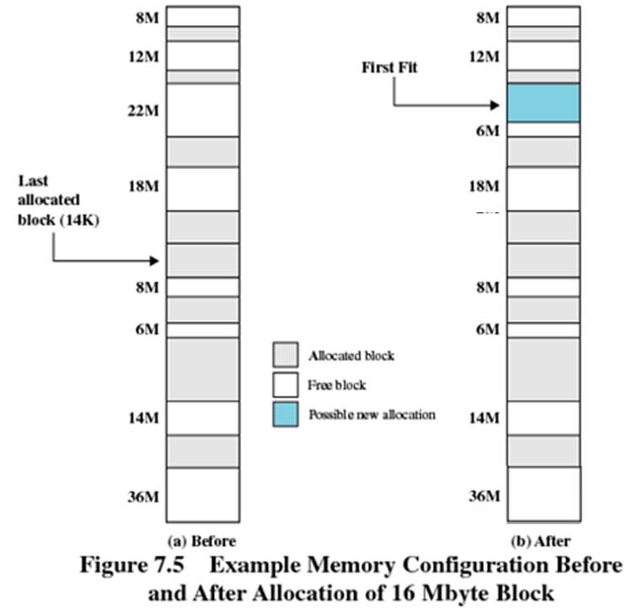
First-fit
Could you draw the situation of the memory after the allocations of series requests: 5, 22, 6, 12?

Slide 46
Dynamic Partitioning Placement Algorithm
First-fit algorithm(首次适配)
Scans memory form the beginning and chooses the first available block that is large enough
Fastest
May have many process loaded in the front end of memory that must be searched over when trying to find a free block
PPTs from others\SCU_Zhaohui\OS\Chapter07.ppt

Slide 47
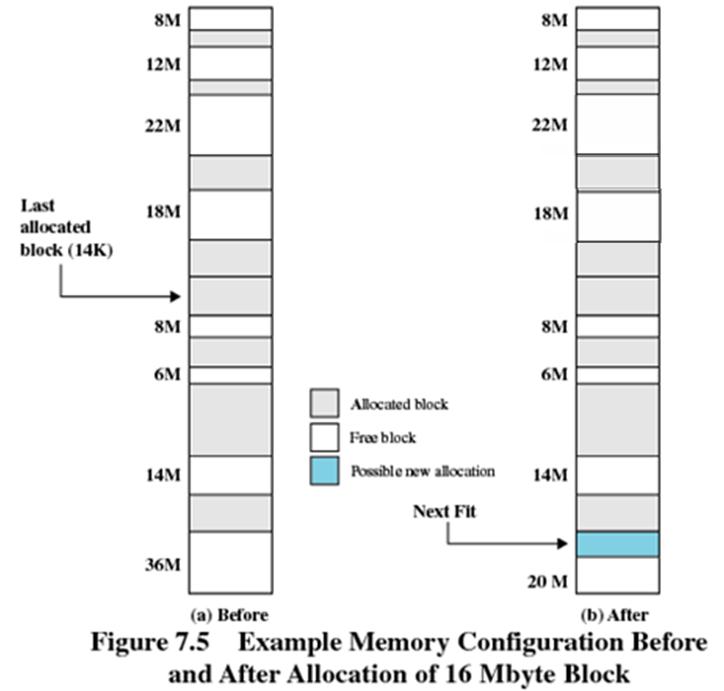
Next-fit
Could you draw the situation of the memory after the allocations of series requests: 5, 22, 6, 12?

Slide 48
Dynamic Partitioning Placement Algorithm
Next-fit(邻近适配)
Scans memory from the location of the last placement
More often allocate a block of memory at the end of memory where the largest block is found
The largest block of memory is broken up into smaller blocks
Compaction is required to obtain a large block at the end of memory
PPTs from others\SCU_Zhaohui\OS\Chapter07.ppt

Slide 49
Internal/External Fragmentation
There are really two types of fragmentation:
Internal Fragmentation – allocated memory may be slightly larger than requested memory; this size difference is memory internal to a partition, but not being used.
External Fragmentation – total memory space exists to satisfy a size n request, but that memory is not contiguous.
PPTs from others\From Ariel J. Frank\OS381\os7-2_rea.ppt

Slide 50
Fragmentation [碎片整理]
 | memory
 | OS
2K
6K | Empty (6K)
12K | empty Empty (3K)
If a whole partition is currently not being used, then it is called an external fragmentation.
P1 (2K)
P2 (9K)
If a partition is being used by a process requiring some memory smaller than the partition size, then it is called an internal fragmentation.
PPTs.2012\PPTs from others\www.eee.metu.edu.tr_~halici_courses_442\ch3part1.ppt

Slide 51
Compaction – Reducing External Fragmentation
External fragmentation can be resolved through compaction [压缩]
Shuffles the memory contents to put all free memory together in one block
OS
P1 12 KB
<FREE> 10 KB
P2 20 KB
P4 3 KB
<FREE> 13 KB
P3 6 KB
<FREE> 4 KB
Memory mapping before compaction

Slide 52
compaction
OS
P1 12 KB
P2 20 KB
P4 3 KB
P3 6 KB
Swap out
P2
PPTs.2012\PPTs from others\www.eee.metu.edu.tr_~halici_courses_442\ch3part1.ppt

Slide 53
compaction
OS
P1 12 KB
P2 20 KB
P4 3 KB
P3 6 KB
Swap in
P2
Secondary
storage
PPTs.2012\PPTs from others\www.eee.metu.edu.tr_~halici_courses_442\ch3part1.ppt

Slide 54
compaction
OS
P1 12 KB
P2 20 KB
P4 3 KB
P3 6 KB
Secondary
storage
Swap out
P4
PPTs.2012\PPTs from others\www.eee.metu.edu.tr_~halici_courses_442\ch3part1.ppt

Slide 55
compaction
OS
P1 12 KB
P2 20 KB
P4 3 KB
P3 6 KB
Swap in
P4 with a different starting address
Secondary
storage
PPTs.2012\PPTs from others\www.eee.metu.edu.tr_~halici_courses_442\ch3part1.ppt

Slide 56
compaction
OS
P1 12 KB
P2 20 KB
P4 3 KB
P3 6 KB
Secondary
storage
Swap out
P3
PPTs.2012\PPTs from others\www.eee.metu.edu.tr_~halici_courses_442\ch3part1.ppt

Slide 57
compaction
OS
P1 12 KB
P2 20 KB
P4 3 KB
P3 6 KB
Swap in
P3
Secondary
storage
PPTs.2012\PPTs from others\www.eee.metu.edu.tr_~halici_courses_442\ch3part1.ppt

Slide 58
compaction
OS
P1 12 KB
P2 20 KB
P4 3 KB
P3 6 KB
<FREE> 27 KB
Memory mapping after compaction
Now P5 of 15KB can be loaded here
PPTs.2012\PPTs from others\www.eee.metu.edu.tr_~halici_courses_442\ch3part1.ppt

Slide 59
compaction
OS
P1 12 KB
P2 20 KB
P4 3 KB
P3 6 KB
P5 12 KB
<FREE> 12 KB
P5 of 15KB is loaded
PPTs.2012\PPTs from others\www.eee.metu.edu.tr_~halici_courses_442\ch3part1.ppt

Slide 60
Only possible if relocation is dynamic
Relocation requires moving program and data, changing the base register
Compaction algorithm is expensive, but so is not making efficient use of memory, especially with a lot of concurrent processes
I/O problem:
Lock job in memory while it is involved in I/O.
Do I/O only into OS buffers.

Slide 61
Concluded rules
MM and program could be cut into segment
why not using same size?
Later paging scheme inherits this with same sized cutting
The segment could be swapped into or out of MM when needed
Swapping is the basis of later VM
Making the MM management to execute your program transparently

Slide 62
Replacement Algorithm [替换算法]
When all processes in main memory are blocked, the OS must choose which process to replace:
A process must be swapped out (to a Blocked-Suspend state) and be replaced by a process from the Ready-Suspend queue or a new process.
Will be discussed in later virtual memory
PPTs from others\From Ariel J. Frank\OS381\os7-2_rea.ppt

Slide 63
Memory
Basic concepts
From Logic address to physical address
MMU for relocation – address translation
Basic techniques of memory management
Partitioning (Static & Dynamic)
Other auxiliary skills – Overlay and DDL
For OS space
Knuth’s Buddy System

Slide 64
Program vs. Memory sizes
What to do when program size is larger than the amount of memory/partition (that exists or can be) allocated to it?
There were two basic attempts within real memory management:
Overlays [覆盖, 现在在嵌入式系统中找到了新的应用]
Dynamic Linking (Libraries – DLLs)
PPTs from others\From Ariel J. Frank\OS381\os7-1_rea.ppt

Slide 65
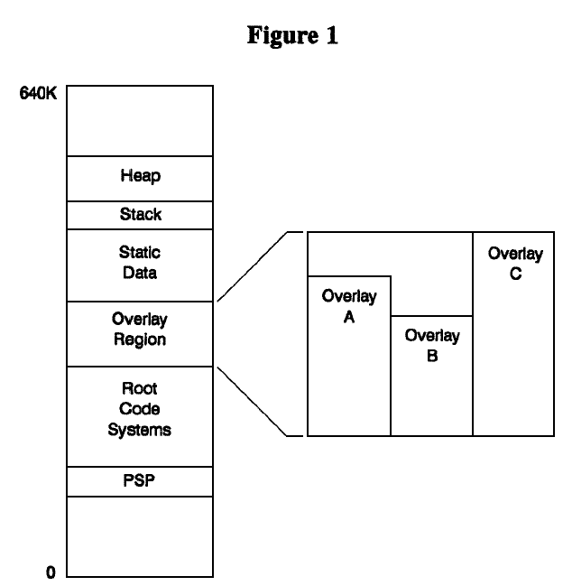
1. Overlay – once known as “Virtual Memory For 640K DOS”
http://www.digitalmars.com/ctg/vcm.html
Overlay schemes work by dividing up a program's code into a root segment and various overlay segments.
The root segment is always resident in memory. The overlay segments are placed into a reserved section of memory, called the overlay region.
An overlay is loaded only when the program calls a function in that overlay.
- When an overlay is loaded, it replaces any existing overlay in the overlay region. The size of the overlay region is the size of the largest overlay segment.

Slide 66
2. Dynamic Linking
Linking postponed until execution time.
Small piece of code, stub, used to locate the appropriate memory-resident library routine.
Stub replaces itself with the address of the routine, and executes the routine.
OS needed to check if routine is in processes’ memory address.
Dynamic linking is particularly useful for shared/common libraries – here full OS support is needed.
PPTs from others\From Ariel J. Frank\OS381\os7-1_rea.ppt

Slide 67
Advantages of Dynamic Linking
Executable files can use another version of the external module without the need of being modified.
Each process is linked to the same external module.
Saves disk space.
The same external module needs to be loaded in main memory only once.
Processes can share code and save memory.
Examples:
Windows: external modules are .DLL files.
Unix: external modules are .SO files (shared library).
Your turn to understand this programming skill
PPTs from others\From Ariel J. Frank\OS381\os7-1_rea.ppt

Slide 68
Memory
Basic concepts
Memory in storage hierarchy
From program to process
Static & Dynamic linking
Requirements of MM
Basic techniques of real memory management
Overlay
Partitioning (Static & Dynamic)
For OS space
Knuth’s Buddy System

Slide 69
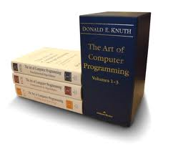
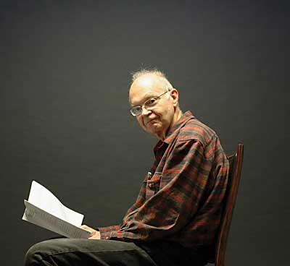
The Art of Computer Programming
There is even a book named after that
Notes:
MacDonald Knuth (唐纳德). This book once is called the Bible of learning programming.

Slide 70
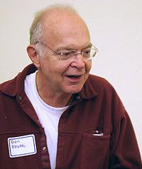

http://www-cs-faculty.stanford.edu/~uno/
Example: Knuth’s Buddy System
Entire space available is treated as a single block of 2^{U}
If a request of size s such that 2^{U-1} < s <= 2^{U}, entire block is allocated
Otherwise block is split into two equal buddies
Process continues until smallest block greater than or equal to s is generated

Slide 71
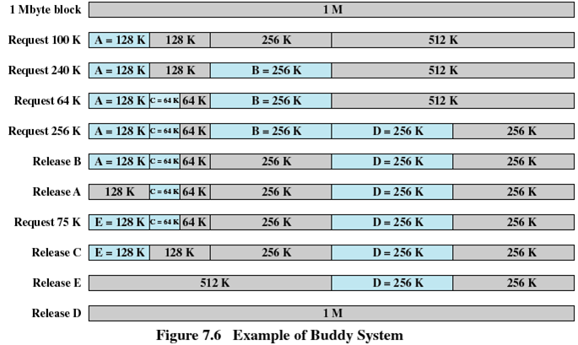
Example of Buddy System
PPTs from others\SCU_Zhaohui\OS\Chapter07.ppt

Slide 72
Dynamics of Buddy System (1)
We start with the entire block of size 2^{U}.
When a request of size S is made:
If 2^{U-1} < S <= 2^{U} then allocate the entire block of size 2^{U}.
Else, split this block into two buddies, each of size 2^{U-1}.
If 2^{U-2} < S <= 2^{U-1} then allocate one of the 2 buddies.
Otherwise one of the 2 buddies is split again.
This process is repeated until the smallest block greater or equal to S is generated.
Two buddies are coalesced whenever both of them become unallocated.
PPTs from others\From Ariel J. Frank\OS381\os7-2_rea.ppt

